Slide 1






Research Track - Graph Data Learning
NeutronTask: Scalable and Efficient Multi-GPU GNN Training
with Task Parallelism
Zhenbo Fu, Xin Ai, Qiange Wang, Yanfeng Zhang, Shizhan Lu, Chaoyi Chen, Chunyu Cao, Hao Yuan, Zhewei Wei, Yu Gu, Yingyou Wen, Ge Yu
Northeastern University, China; National University of Singapore, Singapore;
Renmin University of China; Neusoft AI Magic Technology Research
Notes:
Hello everyone, I’m Fu Zhenbo, a phd student at the Northeastern university of china. Today I will report my recent work on Multi-GPU GNN training system.

Slide 2
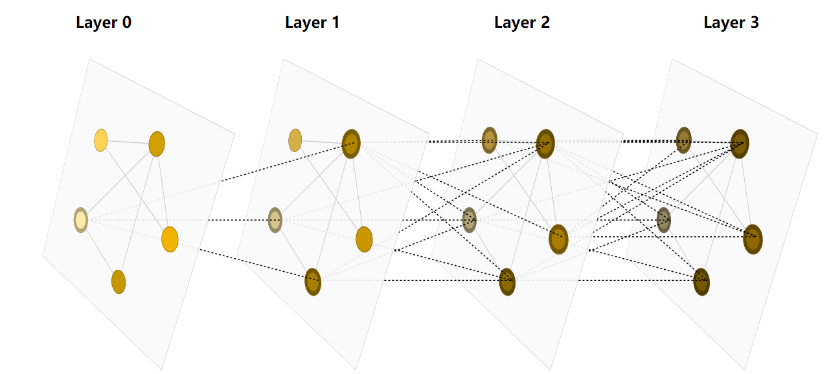
Graph Neural Network （GNN）
4
0
1
2
3
Graph Data
GNN Model
Notes:
Graph neural networks can learn information from graph data

Slide 3

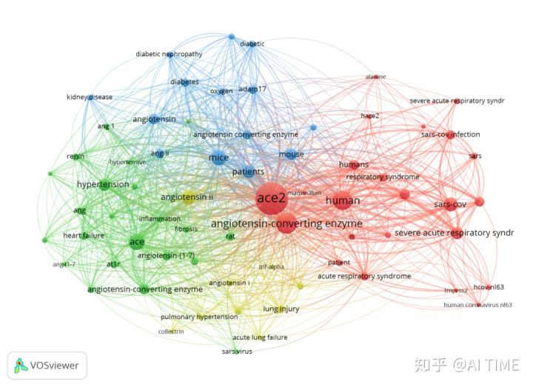

Graph Neural Network （GNN）
4
0
1
2
3
Graph Data
GNN Model
(a) Social Networks
(b) Knowledge Graph
(c) Biological networks
Notes:
Which can be used in many real world applications.

Slide 4
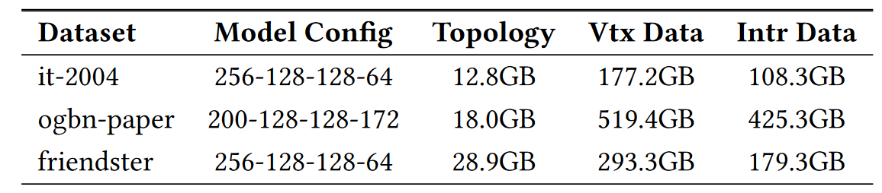
Memory Challenge in GNN Training
Memory consumption of graph topology, vertex (Vtx) data,
and intermediate (Intr) data [HongTu:SIGMOD’24 ]
Memory Resources
Notes:
In practical scenarios, training GNNs requires substantial memory resources.

Slide 5

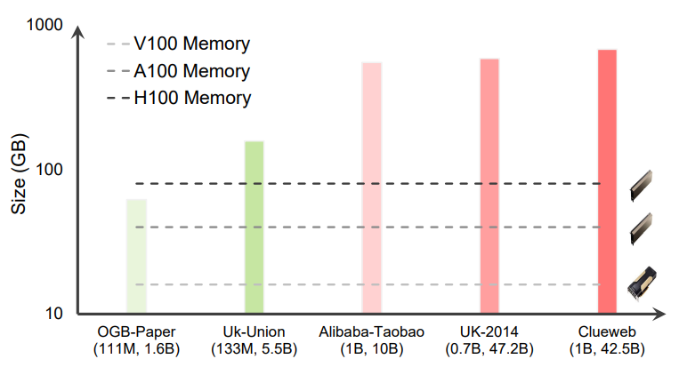
Memory Challenge in GNN Training
hard to scale to large graphs
Memory consumption of graph topology, vertex (Vtx) data,
and intermediate (Intr) data [HongTu:SIGMOD’24 ]
GNN dataset size and current GPU capacities [Legion:ATC’23 ]
Notes:
As the graph scale increases, this issue becomes more severe.

Slide 6
Memory Challenge in GNN Training
hard to scale to large graphs
Memory consumption of graph topology, vertex (Vtx) data,
and intermediate (Intr) data [HongTu:SIGMOD’24 ]
Multi-GPU Platforms
+
Data Parallelism
GNN dataset size and current GPU capacities [Legion:ATC’23 ]
Notes:
To address this challenge, researchers have proposed multi-GPU training and data parallelism

Slide 7
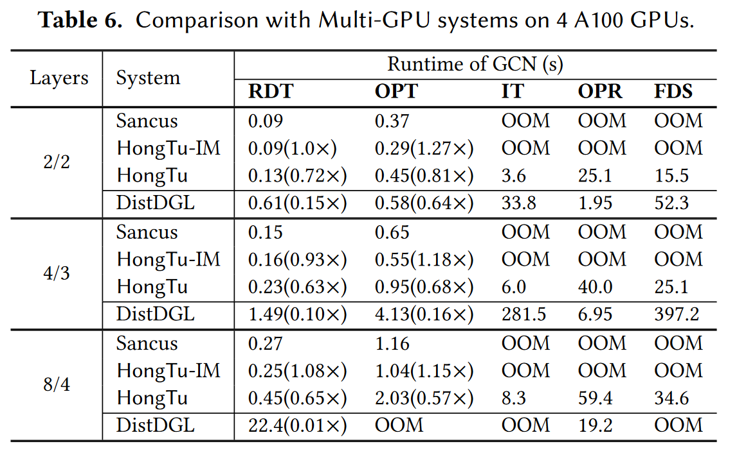
Memory Challenge in GNN Training
hard to scale to large graphs
Multi-GPU Platforms
+
Data Parallelism
Challenge in Training Large-Scale Graphs
Even with 4×A100, in-memory training on large graphs is infeasible [HongTu:SIGMOD’24 ].
Notes:
However, a recent study reveals that even with multiple GPUs, training large-scale GNN remains challenging.

Slide 8
Memory Challenge in GNN Training
hard to scale to large graphs
Analyzing the Sources of Memory Consumption in Multi-GPU Data Parallelism
Multi-GPU Platforms
+
Data Parallelism
Challenge in Training Large-Scale Graphs
Even with 4×A100, in-memory training on large graphs is infeasible [HongTu:SIGMOD’24 ].
Notes:
We analyze the sources of memory consumption from the workflow of existing multi-GPU GNN training.

Slide 9

Multi-GPU GNN Systems with Data Parallelism
0
1
2
3
Feature
Graph
$$X_{0}$$
input
Notes:
The GNN takes the graph topology along with vertex features (X0) as input.

Slide 10
Multi-GPU GNN Systems with Data Parallelism
GPU1
0
1
2
3
Feature
Graph
$$X_{0}$$
GPU2
Inter-GPU Graph Partition
Notes:
Data parallelism partitions the graph data across multiple GPUs to enable parallel training.

Slide 11

Multi-GPU GNN Systems with Data Parallelism
GPU1
0
1
2
3
0
1
2
3
Feature
Graph
$$X_{0}$$
0
1
GPU2
2
3
$$X_{0}$$
Notes:
Each GPU caches local vertices and their features.

Slide 12
Multi-GPU GNN Systems with Data Parallelism
GPU1
0
1
2
3
0
1
2
3
Feature
Graph
$$X_{0}$$
0
1
GPU2
2
3
$$X_{0}$$
The Memory of GPU 1
Notes:
Which generate the memory shown as the green region.

Slide 13
Multi-GPU GNN Systems with Data Parallelism
GPU1
0
1
0
1
2
3
0
1
NN Operation
T Task
2
3
Feature
Graph
$$X_{0}$$
0
1
2
GPU2
3
2
3
$$X_{0}$$
The Memory of GPU 1
Notes:
During the training phase, each GPU first executes the NN operation (T Task),

Slide 14
Multi-GPU GNN Systems with Data Parallelism
GPU1
0
1
0
1
2
3
0
1
T Task
W
2
3
Update
features
Feature
Graph
$$X_{0}$$
0
1
2
GPU2
3
2
3
$$X_{0}$$
The Memory of GPU 1
Notes:
using neural network parameters W to update the vertex features

Slide 15

Multi-GPU GNN Systems with Data Parallelism
GPU1
0
1
0
0
1
1
2
3
0
1
T Task
2
3
Feature
Graph
$$X_{0}$$
0
1
2
2
GPU2
3
3
2
3
$$X_{0}$$
$$X_{1}$$
The Memory of GPU 1
Notes:
The output of the T task is the vertex embeddings (X1),

Slide 16
Multi-GPU GNN Systems with Data Parallelism
GPU1
0
1
0
0
1
1
2
3
0
1
T Task
2
3
Feature
Graph
$$X_{0}$$
0
1
2
2
GPU2
3
3
2
3
$$X_{0}$$
$$X_{1}$$
Intermediate Data
The Memory of GPU 1
Notes:
which need to be stored in GPU memory.

Slide 17
Multi-GPU GNN Systems with Data Parallelism
GPU1
0
1
0
0
1
1
2
3
0
1
Graph Propagation
T Task
P Task
2
3
Aggregate
Neighbor Embeddings
Feature
Graph
$$X_{0}$$
0
1
2
2
GPU2
3
3
2
3
$$X_{0}$$
$$X_{1}$$
Intermediate Data
The Memory of GPU 1
Notes:
Next, each GPU performs the graph propagation operation (P task), aggregating the neighbor embeddings.

Slide 18
Multi-GPU GNN Systems with Data Parallelism
GPU1
0
1
0
0
1
1
2
3
0
1
T Task
P Task
2
3
Inter-GPU Graph Partition → Vertex Dependency
Aggregate
Neighbor Embeddings
Feature
Graph
$$X_{0}$$
0
1
2
2
GPU2
3
3
2
3
$$X_{0}$$
$$X_{1}$$
Intermediate Data
The Memory of GPU 1
Notes:
The inter-GPU graph partition generates cross-GPU vertex dependency，to manage these dependencies

Slide 19
Multi-GPU GNN Systems with Data Parallelism
GPU1
0
1
0
0
1
1
2
3
0
1
T Task
P Task
2
3
Inter-GPU Graph Partition → Vertex Dependency
Feature
Graph
$$X_{0}$$
0
1
2
2
GPU2
3
3
2
3
$$X_{0}$$
$$X_{1}$$
Intermediate Data
The Memory of GPU 1
Notes:
Data parallelism involves inter-GPU communication to fetch remote vertex data

Slide 20
Multi-GPU GNN Systems with Data Parallelism
GPU1
0
1
0
0
2
1
1
2
3
3
0
1
T Task
P Task
2
3
Inter-GPU Graph Partition → Vertex Dependency
0
Feature
Graph
1
$$X_{0}$$
0
1
2
2
GPU2
3
3
2
3
$$X_{0}$$
$$X_{1}$$
Intermediate Data
The Memory of GPU 1
Notes:
followed by creating local replicas of these remote vertices.

Slide 21
Multi-GPU GNN Systems with Data Parallelism
GPU1
0
1
0
0
2
1
1
2
3
3
0
1
T Task
P Task
2
3
Inter-GPU Graph Partition → Vertex Dependency
0
Feature
Graph
1
$$X_{0}$$
0
1
2
2
GPU2
3
3
2
3
$$X_{0}$$
$$X_{1}$$
Intermediate Data
Neighbor Replication
The Memory of GPU 1
Notes:
This process generates memory usage from neighbor replication within each GPU.

Slide 22
Multi-GPU GNN Systems with Data Parallelism
0
0
GPU1
1
1
0
1
0
0
2
1
1
2
3
3
0
1
T Task
P Task
2
3
Inter-GPU Graph Partition → Vertex Dependency
0
Feature
Graph
1
$$X_{0}$$
0
1
2
2
2
2
GPU2
3
3
2
3
3
3
$$X_{0}$$
$$X_{1}$$
Intermediate Data
Neighbor Replication
The Memory of GPU 1
Notes:
After fetching all neighbors, each GPU can execute the P task locally.

Slide 23

Multi-GPU GNN Systems with Data Parallelism
0
0
GPU1
1
1
0
1
0
0
2
1
1
2
3
3
0
1
T Task
P Task
2
3
Inter-GPU Graph Partition → Vertex Dependency
0
Feature
Graph
1
$$X_{0}$$
0
1
2
2
2
2
GPU2
3
3
2
3
3
3
$$X_{0}$$
$$X_{1}$$
$$H_{1}$$
Intermediate Data
Neighbor Replication
Intermediate Data
The Memory of GPU 1
Notes:
The results produced by the P task still need to be stored in GPU memory to perform computations for the next layer.

Slide 24








Multi-GPU GNN Systems with Data Parallelism
Layer 1
Layer 2
T Task
P Task
T Task
P Task
Forward
$$X_{0}$$
$$F_{W}()$$
$$X_{1}$$
$$H_{1}$$
$$F_{W}()$$
$$X_{2}$$
$$H_{2}$$
$$Loss$$
The Memory of GPU 1
Notes:
As the number of GNN layers increases, memory consumption grows linearly.

Slide 25
Multi-GPU GNN Systems with Data Parallelism
Layer 1
Layer 2
T Task
P Task
T Task
P Task
Forward
$$X_{0}$$
$$F_{W}()$$
$$X_{1}$$
$$H_{1}$$
$$F_{W}()$$
$$X_{2}$$
$$H_{2}$$
$$Loss$$
Intermediate Data and Neighbor Replication
The Memory of GPU 1
Notes:
During forward computation, the inputs and outputs of all T and P tasks need to be stored,,, as intermediate data.

Slide 26
Multi-GPU GNN Systems with Data Parallelism
Layer 1
Layer 2
T Task
P Task
T Task
P Task
Forward
$$X_{0}$$
$$F_{W}()$$
$$X_{1}$$
$$H_{1}$$
$$F_{W}()$$
$$X_{2}$$
$$H_{2}$$
$$Loss$$
Intermediate Data and Neighbor Replication
The Memory of GPU 1
Notes:
Then, why do we need to cache intermediate data?

Slide 27








Multi-GPU GNN Systems with Data Parallelism
Layer 1
Layer 2
T Task
P Task
T Task
P Task
Forward
$$X_{0}$$
$$F_{W}()$$
$$X_{1}$$
$$H_{1}$$
$$F_{W}()$$
$$X_{2}$$
$$H_{2}$$
$$∇W^{(1)}$$
Need Gradients
$$∇W^{(2)}$$
$$Loss$$
Backward
$$F_{W}^{−1}()$$
$${∇X}_{1}$$
$${∇H}_{1}$$
$$F_{W}^{−1}()$$
$${∇X}_{2}$$
$${∇H}_{2}$$
The Memory of GPU 1
Notes:
In fact, during backward propagation, we need the gradients of neural network parameters.

Slide 28
Multi-GPU GNN Systems with Data Parallelism
Layer 1
Layer 2
T Task
P Task
T Task
P Task
Forward
$$X_{0}$$
$$F_{W}()$$
$$X_{1}$$
$$H_{1}$$
$$F_{W}()$$
$$X_{2}$$
$$H_{2}$$
$$∇W^{(1)}$$
$$∇W^{(2)}$$
$$Loss$$
Backward
$$F_{W}^{−1}()$$
$${∇X}_{1}$$
$${∇H}_{1}$$
$$F_{W}^{−1}()$$
$${∇X}_{2}$$
$${∇H}_{2}$$
Requires intermediate data
The Memory of GPU 1
Notes:
These computations require these intermediate data.

Slide 29
Multi-GPU GNN Systems with Data Parallelism
Layer 1
Layer 2
T Task
P Task
T Task
P Task
Forward
$$X_{0}$$
$$F_{W}()$$
$$X_{1}$$
$$H_{1}$$
$$F_{W}()$$
$$X_{2}$$
$$H_{2}$$
$$∇W^{(1)}$$
$$∇W^{(2)}$$
$$Loss$$
Backward
Learnable NN Parameter
$$F_{W}()$$
$${∇X}_{1}$$
$${∇H}_{1}$$
$$F_{W}()$$
$${∇X}_{2}$$
$${∇H}_{2}$$
The Memory of GPU 1
Notes:
In entire training, only the T tasks contain parameters,

Slide 30
Multi-GPU GNN Systems with Data Parallelism
Linear Computation
Layer 1
Layer 2
T Task
P Task
T Task
P Task
Forward
$$X_{0}$$
$$F_{W}()$$
$$X_{1}$$
$$H_{1}$$
$$F_{W}()$$
$$X_{2}$$
$$H_{2}$$
$$∇W^{(1)}$$
$$∇W^{(2)}$$
$$Loss$$
Backward
$$F_{W}^{−1}()$$
$${∇X}_{1}$$
$${∇H}_{1}$$
$$F_{W}^{−1}()$$
$${∇X}_{2}$$
$${∇H}_{2}$$
The Memory of GPU 1
Notes:
while the P tasks involve linear aggregation computations

Slide 31
Multi-GPU GNN Systems with Data Parallelism
Linear Computation
Layer 1
Layer 2
T Task
P Task
T Task
P Task
Forward
$$X_{0}$$
$$F_{W}()$$
$$X_{1}$$
$$H_{1}$$
$$F_{W}()$$
$$X_{2}$$
$$H_{2}$$
$$∇W^{(1)}$$
No Parameter
$$∇W^{(2)}$$
$$Loss$$
Backward
$$F_{W}^{−1}()$$
$${∇X}_{1}$$
$${∇H}_{1}$$
$$F_{W}^{−1}()$$
$${∇X}_{2}$$
$${∇H}_{2}$$
The Memory of GPU 1
Notes:
As shown in this Figure, although P tasks contain no parameters, the H one and H two still be stored.

Slide 32
Multi-GPU GNN Systems with Data Parallelism
Layer 1
Layer 2
T Task
P Task
T Task
P Task
Forward
$$X_{0}$$
$$F_{W}()$$
$$X_{1}$$
$$H_{1}$$
$$F_{W}()$$
$$X_{2}$$
$$H_{2}$$
$$∇W^{(1)}$$
$$∇W^{(2)}$$
$$Loss$$
Alternating Execution
of T and P Tasks
The output of P Tasks involved
in the computation of T tasks
Backward
$$F_{W}()$$
$${∇X}_{1}$$
$${∇H}_{1}$$
$$F_{W}()$$
$${∇X}_{2}$$
$${∇H}_{2}$$
The Memory of GPU 1
Notes:
This is because the alternating execution of P and T tasks makes the output of P tasks serve as the input to T tasks.

Slide 33
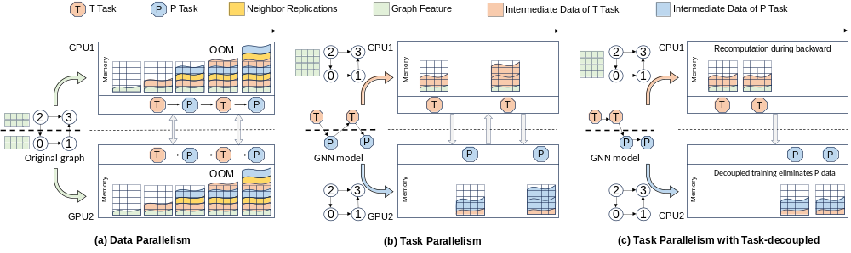
Limitations
Neighbor
Replication
High Memory
Consumption
Intermediate
Data
Notes:
In summary, the memory consumption of GNN training mainly comes from neighbor replication and intermediate data.

Slide 34
Limitations
Neighbor
Replication
Inter-GPU
Graph Partition
High Memory
Consumption
Intermediate
Data
Notes:
The root cause of neighbor replication is inter-GPU graph partition.

Slide 35
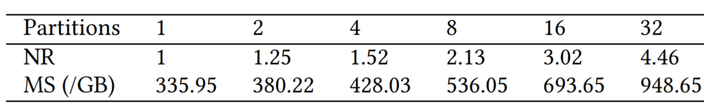
Limitations
Neighbor
Replication
Inter-GPU
Graph Partition
High Memory
Consumption
Intermediate
Data
Neighbor replication factor (NR) and total memory consumption (MS) on ogbn-papers100M
Notes:
We quantify the size of neighbor replication using the replication factor,
defined as the average number of replicas per vertex.

Slide 36
Limitations
Neighbor
Replication
Inter-GPU
Graph Partition
High Memory
Consumption
Intermediate
Data
Neighbor replication factor (NR) and total memory consumption (MS) on ogbn-papers100M
Notes:
As the number of partitions expands from one to thirty two,

Slide 37
Limitations
Neighbor
Replication
Inter-GPU
Graph Partition
High Memory
Consumption
Intermediate
Data
3×
Neighbor replication factor (NR) and total memory consumption (MS) on ogbn-papers100M
Notes:
neighbor replication causes the total memory consumption to increase by three times.

Slide 38
Limitations
Neighbor
Replication
Inter-GPU
Graph Partition
High Memory
Consumption
Intermediate
Data
Task Alternating
Execution
Notes:
Meanwhile, the alternating execution of tasks is a key reason for the large proportion of intermediate data.

Slide 39
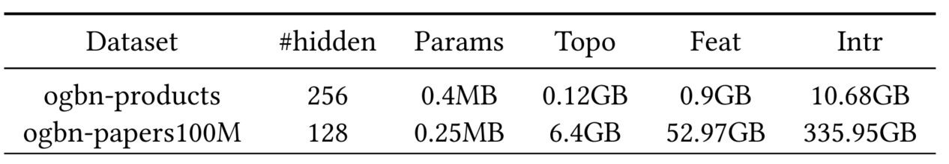
Limitations
Neighbor
Replication
Inter-GPU
Graph Partition
High Memory
Consumption
Intermediate
Data
Task Alternating
Execution
Memory consumption of graph topology (Topo), feature (Feat), model parameters (Params), and intermediate data (Intr)
Notes:
As shown in this table, for a three-layer GCN training

Slide 40
Limitations
Neighbor
Replication
Inter-GPU
Graph Partition
High Memory
Consumption
Intermediate
Data
Task Alternating
Execution
86%
Memory consumption of graph topology (Topo), feature (Feat), model parameters (Params), and intermediate data (Intr)
Notes:
the intermediate data averages eighty-six percent of total memory usage.

Slide 41
NeutronTask
Issue:
Neighbor
Replication
Inter-GPU
Graph Partition
High Memory
Consumption
Intermediate
Data
Task Alternating
Execution
Notes:
This motivates us to design a new task scheduling and execution framework to reduce memory consumption.

Slide 42
NeutronTask
Issue:
Contributions:
Neighbor
Replication
Inter-GPU
Graph Partition
GNN
Task Parallelism
High Memory
Consumption
Solve
Intermediate
Data
Task Alternating
Execution
Task-decoupled
GNN Training Framework
Notes:
We propose NeutronTask, a multi-GPU system for large-scale GNN training, which reduces memory consumption through two techniques: GNN task parallelism and task-decoupled GNN training framework.

Slide 43
NeutronTask — Contribution 1 (Task Parallelism)
Neighbor
Replication
Inter-GPU
Graph Partition
Intermediate
Data
Task Alternating
Execution
Notes:
GNN task parallelism can reduce neighbor replication.

Slide 44
NeutronTask — Contribution 1 (Task Parallelism)
Neighbor
Replication
Inter-GPU
Graph Partition
Avoid
Intermediate
Data
Task Alternating
Execution
Notes:
To avoid inter-GPU graph partition,

Slide 45
NeutronTask — Contribution 1 (Task Parallelism)
Neighbor
Replication
Inter-GPU
Graph Partition
Avoid
Inter-GPU
Task Partition
Intermediate
Data
Task Alternating
Execution
Notes:
we partition the T and P tasks of each model layer across different GPUs.

Slide 46
NeutronTask — Contribution 1 (Task Parallelism)
Each GPU Manages Only The Allocated Tasks
Neighbor
Replication
Inter-GPU
Graph Partition
Avoid
Inter-GPU
Task Partition
Intermediate
Data
Task Alternating
Execution
Notes:
With this approach, each GPU only needs to manage the intermediate data of the allocated tasks

Slide 47
NeutronTask — Contribution 1 (Task Parallelism)
Each GPU Manages Only The Allocated Tasks
Neighbor
Replication
Inter-GPU
Graph Partition
Avoid
Inter-GPU
Task Partition
Intermediate
Data
Task Alternating
Execution
Notes:
rather than managing all tasks and neighbor replications as in data parallelism.

Slide 48
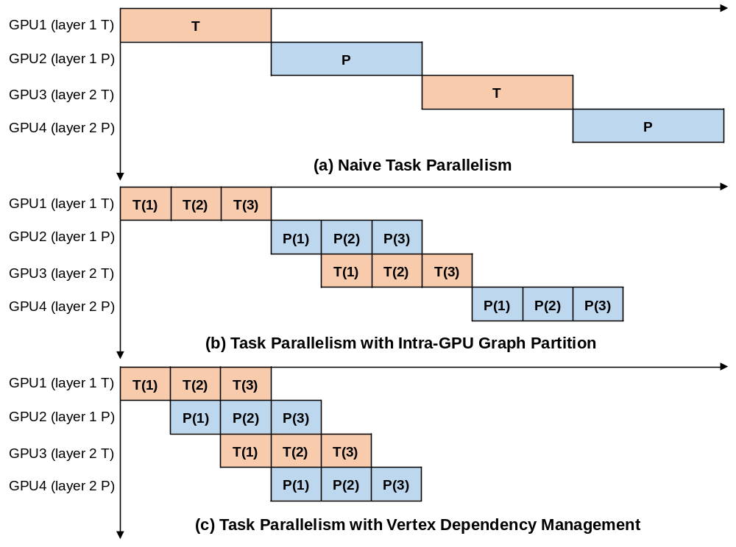
Task Parallelism
The forward propagation of a 2-layer GNN model
Serial Execution
GPU Idleness
Notes:
However, serial execution of tasks often leads to GPU idleness without parallelism.

Slide 49
Task Parallelism
GPU 1 Memory
The forward propagation of a 2-layer GNN model
Serial Execution
GPU Idleness
Larger Graph
OOM
Notes:
In addition, when the intermediate data generated by the allocated tasks exceeds the memory capacity of a single GPU, task parallelism remains challenging.

Slide 50
Task Parallelism
GPU 1 Memory
Intra-GPU Graph Partition:
  Chunk-based Graph Structure
  Vertex Dependency
Each
GPU
0
1
1
…
3
2
3
Reduce The Training Unit Size
Subgraph1
Subgraph2
Notes:
Therefore, we propose intra-GPU graph partition to reduce the training unit size

Slide 51
Task Parallelism
GPU 1 Memory
Intra-GPU Graph Partition:
  Chunk-based Graph Structure
  Vertex Dependency
The forward propagation of a 2-layer GNN model. (i) represents the 𝑖-th subgraph.
Each
GPU
0
1
1
…
3
2
3
Subgraph1
Subgraph2
Notes:
and execute computations in parallel across GPUs.

Slide 52
Task Parallelism
GPU 1 Memory
Intra-GPU Graph Partition:
  Chunk-based Graph Structure
  Vertex Dependency
The forward propagation of a 2-layer GNN model. (i) represents the 𝑖-th subgraph.
Each
GPU
0
1
1
…
3
2
3
Subgraph1
Subgraph2
Notes:
Since P tasks need to aggregate neighbors from other subgraphs, this approach incurs GPU idle time.

Slide 53
Task Parallelism
GPU 1 Memory
Intra-GPU Graph Partition:
  Chunk-based Graph Structure
  Vertex Dependency
Vertex Dependency Management:
  Neighbor Cache and Reuse for Pre-chunk
  Subgraph Reorganization Before Each Epoch
  Task-level Pipeline Parallelism
  Overlap Communication and Computation
Notes:
Then, we execute Subgraph 1 in advance to achieve task-level pipeline parallelism.

Slide 54
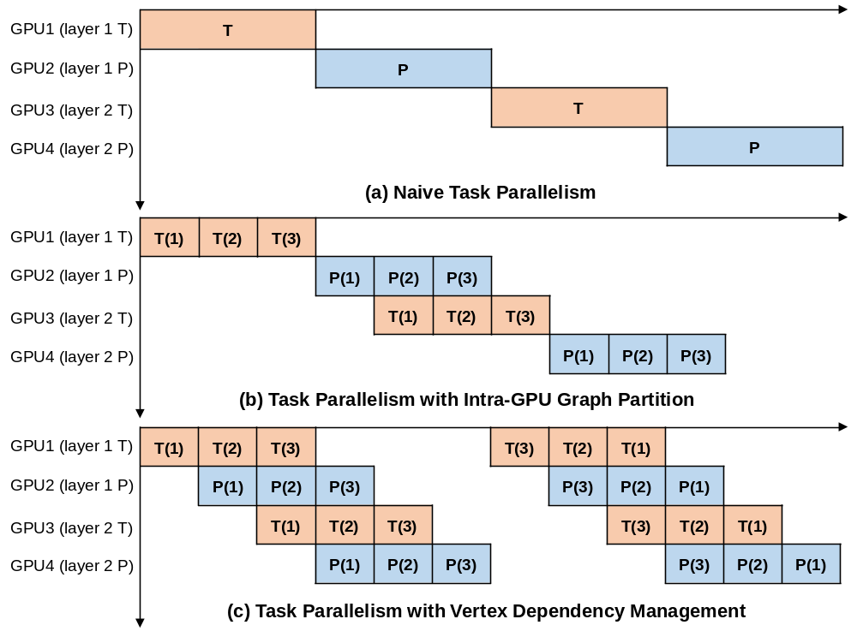
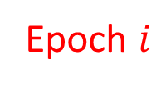
Task Parallelism
Epoch $i$
GPU2
0
1
1
×
√
3
2
3
Subgraph1
Subgraph2
Vertex Dependency Management:
  Neighbor Cache and Reuse for Pre-chunk
  Subgraph Reorganization Before Each Epoch
  Task-level Pipeline Parallelism
  Overlap Communication and Computation
Notes:
Although Subgraph 1 drops the neighbors of Subgraphs 2 and 3

Slide 55
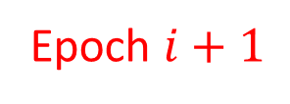
Task Parallelism
Epoch $i$
Epoch $i+1$
GPU2
GPU2
0
1
1
1
0
1
×
√
×
√
…
3
2
3
2
3
3
Subgraph1
Subgraph2
Subgraph2
Subgraph1
Mitigate Accuracy Loss
Vertex Dependency Management:
  Neighbor Cache and Reuse for Pre-chunk
  Subgraph Reorganization Before Each Epoch
  Task-level Pipeline Parallelism
  Overlap Communication and Computation
Notes:
we mitigate accuracy loss by re-organizing subgraphs to adjust the dropped edges.

Slide 56
Task Parallelism
  2-layer GNN
  Only 4 Task (T、T、P、P)
  8 GPUs
GPU 1
GPU 3
GPU 5
GPU 7
GPU 2
GPU 4
GPU 6
GPU 8
Notes:
A challenge arises when the number of GPUs exceeds the number of tasks.

Slide 57
Task Parallelism
  2-layer GNN
  Only 4 Task (T、T、P、P)
Group 1
Group 2
Group 3
Group 4
  8 GPUs
GPU 1
GPU 3
GPU 5
GPU 7
GPU 2
GPU 4
GPU 6
GPU 8
Hybrid Parallelism
Notes:
We propose hybrid parallelism, which groups GPU,

Slide 58
Task Parallelism
Graph Communication
  2-layer GNN
  Only 4 Task (T、T、P、P)
Group 1
Group 2
Group 3
Group 4
  8 GPUs
GPU 1
GPU 3
GPU 5
GPU 7
GPU 2
GPU 4
GPU 6
GPU 8
Hybrid Parallelism
Data
Parallelism
Data
Parallelism
Data
Parallelism
Data
Parallelism
  Data Parallelism Within Groups
T Task
P Task
T Task
P Task
Notes:
with data parallelism within groups,

Slide 59
Task Parallelism
Graph Communication
Task Communication
  2-layer GNN
  Only 4 Task (T、T、P、P)
Group 1
Group 2
Group 3
Group 4
  8 GPUs
GPU 1
GPU 3
GPU 5
GPU 7
GPU 2
GPU 4
GPU 6
GPU 8
Hybrid Parallelism
Data
Parallelism
Data
Parallelism
Data
Parallelism
Data
Parallelism
  Data Parallelism Within Groups
  Task Parallelism Between Groups
T Task
P Task
T Task
P Task
Task Parallelism
Notes:
and task parallelism between groups.

Slide 60
Task Parallelism
Graph Communication
Task Communication
  2-layer GNN
  Only 4 Task (T、T、P、P)
Group 1
Group 2
Group 3
Group 4
  8 GPUs
GPU 1
GPU 3
GPU 5
GPU 7
GPU 2
GPU 4
GPU 6
GPU 8
Hybrid Parallelism
Data
Parallelism
Data
Parallelism
Data
Parallelism
Data
Parallelism
  Data Parallelism Within Groups
  Task Parallelism Between Groups
T Task
P Task
T Task
P Task
Task Parallelism
Neighbor Replication Only in P-task Group
Avoiding Additional Storage Improving GPU Utilization
Notes:
With this method, neighbor replication occurs only within the P task group, avoiding additional storage and improving GPU utilization.

Slide 61
NeutronTask — Contribution 1 (Task Parallelism)
Neighbor
Replication
Inter-GPU
Graph Partition
Intermediate
Data
Task Alternating
Execution
Notes:
Secondly, to reduce the memory consumption of intermediate data,

Slide 62
NeutronTask — Contribution 1 (Task Parallelism)
Neighbor
Replication
Inter-GPU
Graph Partition
Task-decouple
GNN Training
Intermediate
Data
Task Alternating
Execution
Notes:
we propose decoupled training.

Slide 63
NeutronTask — Contribution 1 (Task Parallelism)
T
T
Neighbor
Replication
Inter-GPU
Graph Partition
Task-decouple
GNN Training
Intermediate
Data
Task Alternating
Execution
Notes:
We first execute all T tasks,

Slide 64
NeutronTask — Contribution 1 (Task Parallelism)
T
T
  DNN Training
Neighbor
Replication
Inter-GPU
Graph Partition
Task-decouple
GNN Training
Intermediate
Data
Task Alternating
Execution
Notes:
Which can be seen as a traditional DNN operation.

Slide 65
NeutronTask — Contribution 1 (Task Parallelism)
T
T
  DNN Training
Neighbor
Replication
Inter-GPU
Graph Partition
  Recomputation
Task-decouple
GNN Training
  Forward: Release intr of T Task
  Backward: Re-forward of T Task
Intermediate
Data
Task Alternating
Execution
  Release Intr of T Task
Notes:
We can use re-computation techniques to reduce the intermediate data generated by T tasks.

Slide 66
NeutronTask — Contribution 1 (Task Parallelism)
T
T
T
P
P
P
P
Neighbor
Replication
Inter-GPU
Graph Partition
Task-decouple
GNN Training
Intermediate
Data
Task Alternating
Execution
Notes:
Then, we execute all P tasks

Slide 67
NeutronTask — Contribution 1 (Task Parallelism)
T
T
T
P
P
P
P
Neighbor
Replication
Inter-GPU
Graph Partition
Task-decouple
GNN Training
No Parameter
Intermediate
Data
Task Alternating
Execution
Notes:
Since P tasks do not involve parameters

Slide 68
NeutronTask — Contribution 1 (Task Parallelism)
T
T
T
P
P
P
P
Neighbor
Replication
Inter-GPU
Graph Partition
Task-decouple
GNN Training
No Parameter
Intermediate
Data
Task Alternating
Execution
  Release Intr of P Task
Notes:
we can immediately release the intermediate data generated by P tasks.

Slide 69
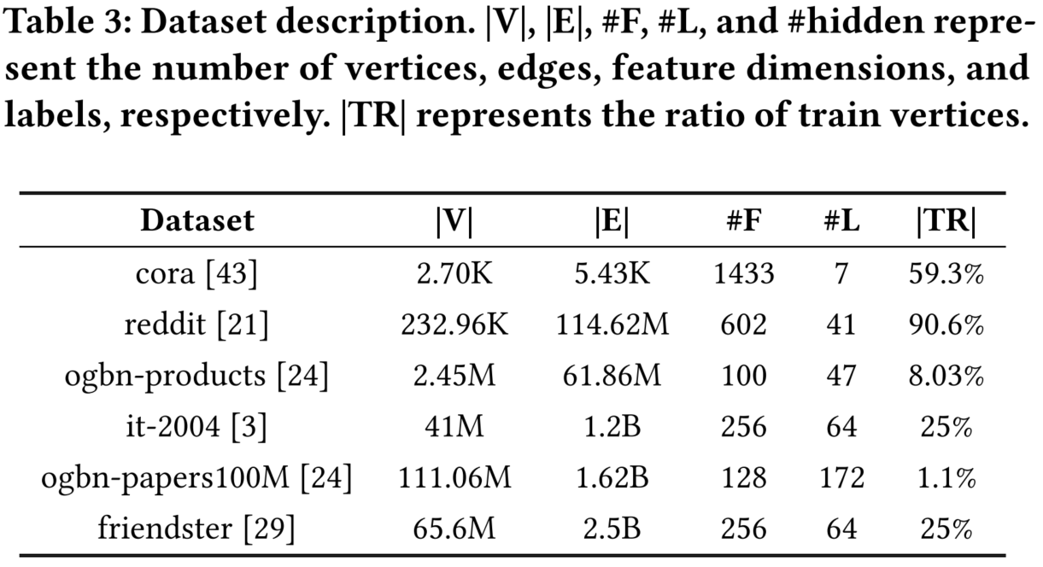
Experimental Setting
  Competitors: DGL [ICLR’19], Sancus [VLDB’22], NeutronStar [SIGMOD’22]
  Test Platforms:
    GPU server equipped with 2 Intel(R) Xeon(R) Silver 4316 CPUs,
    377GB DRAM, and 4 NVIDIA A5000 (24GB)
    Algorithms and Datasets:
    2 Graph Neural Networks
    GCN, GAT
    6 real world graphs
    Software Environment:
    Ubuntu 20.04 OS
    GCC 9.4.0
    CUDA 11.3
    PyTorch 1.13.0
Notes:
To show the effectiveness of our system, we compare it with DGL, Sancus , and NeutronStar.

Slide 70
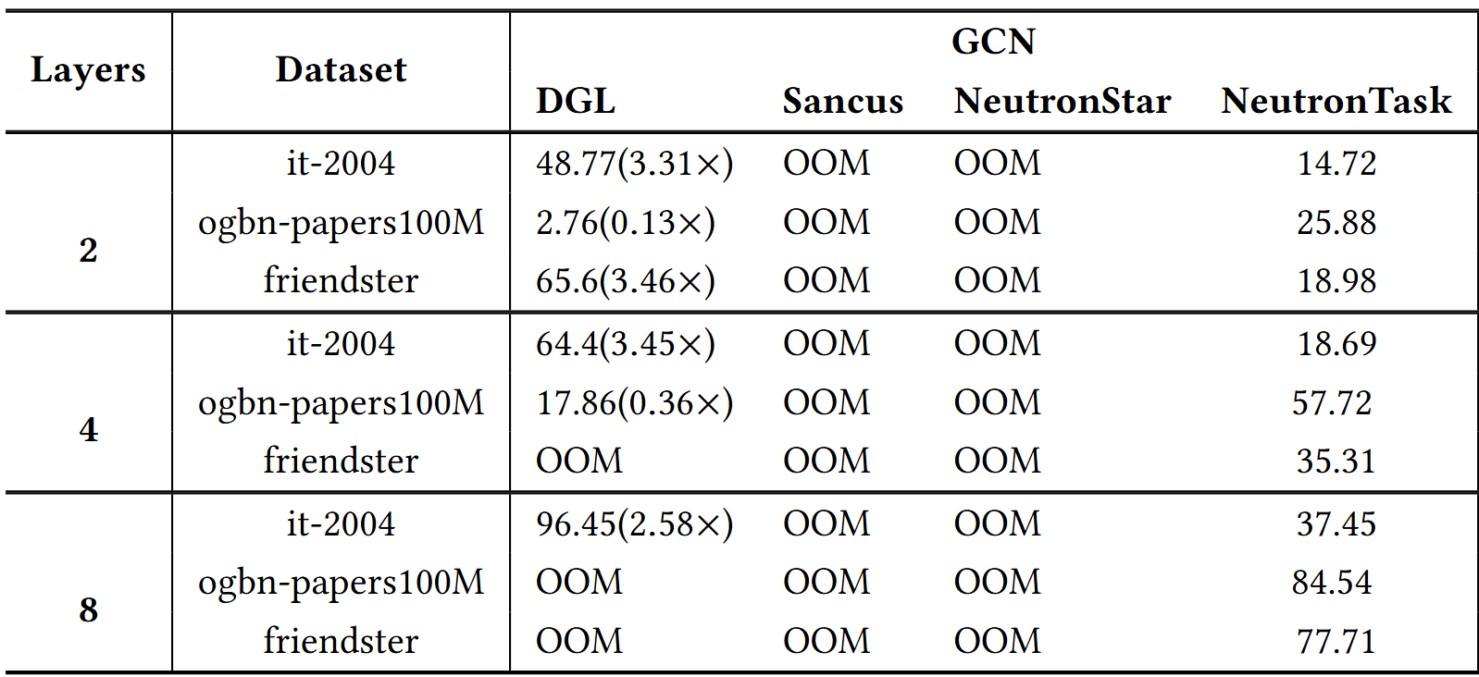
Overall Comparison
Partial Experimental Results
NeutronTask can training all graph
1.81X-9.3X faster than DGL
1.52X-5.47X faster than Sancus
1.58X-3.25X faster than Nts
NeutronTask can support the training of graphs of all sizes, whereas DGL, Sancus, and NeutronStar encountered OOM (Out of Memory) errors under various conditions.
Notes:
We can observe that NeutronTask shows better performance than the baselines. Importantly, NeutronTask supports large-scale GNN training.

Slide 71
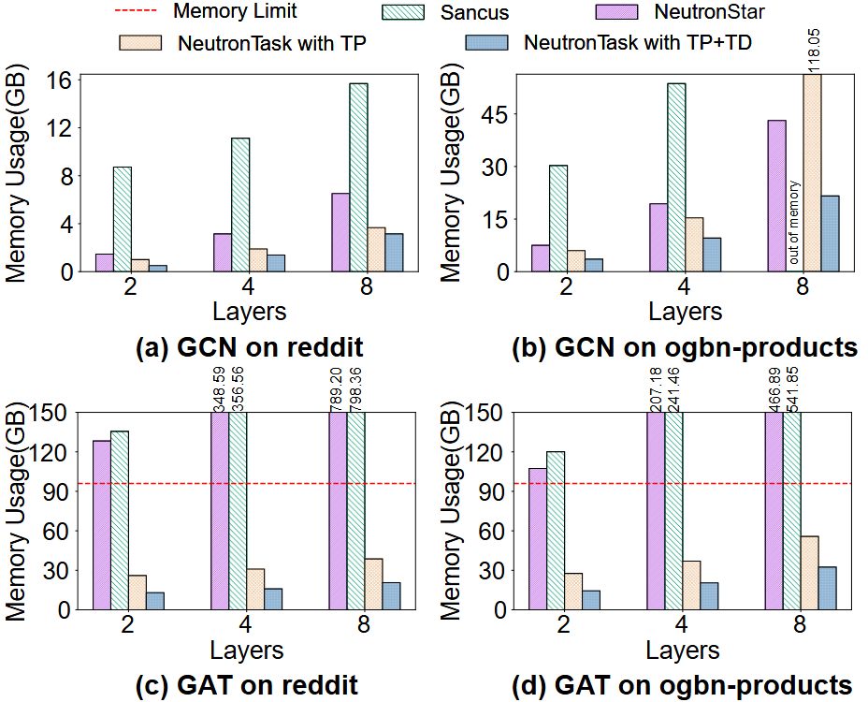
Memory Reduction Analysis
NeutronStar cache neighbor replication by 19.9% − 43.7%
Sancus additionally caches historical embeddings by 32.7% − 43.3%
NeutronStar and Sancus cache intermediate data by 17.6% − 28.9%
NeutronTask reduces total memory consumption by 49% − 67%
Notes:
We analyze the memory reduction achieved by task parallelism and task-decoupled training. NeutronTask can complete GNN training with minimal memory consumption.

Slide 72
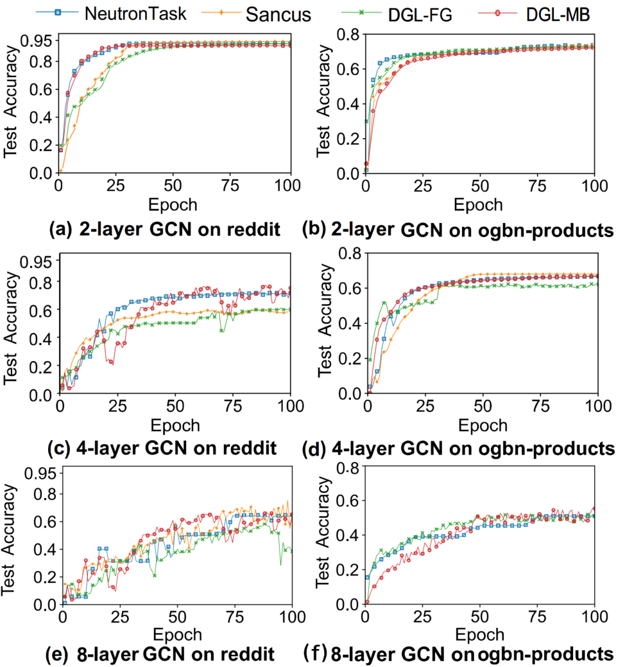
Accuracy Comparison
FG: Full-graph training MB: mini-batch training
NeutronTask achieves almost the same accuracy as other systems
NeutronTask achieves the highest accuracy in fewer epochs and time.
Notes:
NeutronTask achieves almost the same accuracy as existing systems while improving performance and reducing memory consumption.

Slide 73
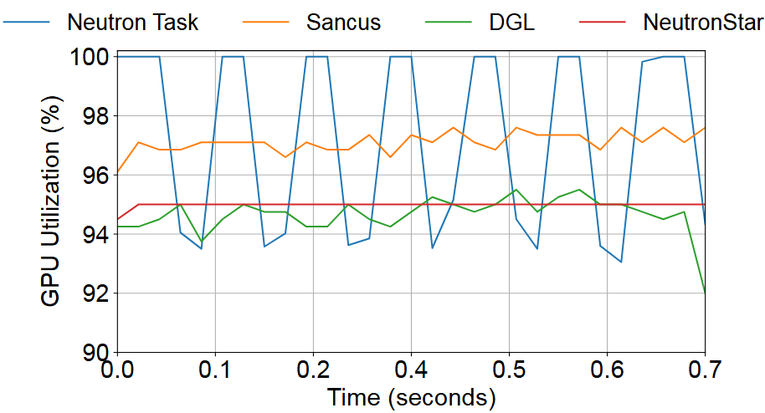
GPU utilization
NeutronTask fully utilizes GPU computing resources, achieving better performance
High GPU utilization ensures shorter runtime, while the fluctuation is caused by pipeline bubble time.
The average GPU utilizations are 97.24%, 97.11%, 94.65%, and 94.89% for Neu-tronTask, Sancus, DGL, and NeutronStar, respectively.
Notes:
In addition, we evaluate the GPU utilization of different system. The performance advantage of NeutronTask stems from the high GPU utilization through task-level pipelining.

Slide 74
Summary
    NeutronTask: Scalable and Efficient Multi-GPU GNN Training
    with Task Parallelism
    Providing analysis of memory requirements for full-graph training
    We provide a comprehensive analysis of memory requirements for full-graph GNN training on Multi-GPU platforms, including neighbor replication and intermediate data.
Notes:
In summary, we provide a comprehensive analysis of memory requirements for full-graph GNN training on Multi-GPU platforms, including neighbor replication and intermediate data.

Slide 75
Summary
    NeutronTask: Scalable and Efficient Multi-GPU GNN Training
    with Task Parallelism
    Providing analysis of memory requirements for full-graph training
    Proposing a GNN task parallelism technique
    We provide a comprehensive analysis of memory requirements for full-graph GNN training on Multi-GPU platforms, including neighbor replication and intermediate data.
    We propose GNN task parallelism, which reduces neighbor replication by partitioning tasks across GPUs and partitioning graph of each task within a GPU, instead of partitioning graph data across GPUs.
Notes:
We propose GNN task parallelism, which reduces neighbor replication by partitioning tasks across GPUs and partitioning graph of each task within a GPU, instead of partitioning graph data across GPUs

Slide 76
Summary
    NeutronTask: Scalable and Efficient Multi-GPU GNN Training
    with Task Parallelism
    Providing analysis of memory requirements for full-graph training
    Proposing a GNN task parallelism technique
    Proposing a task-decoupled GNN training framework
    We provide a comprehensive analysis of memory requirements for full-graph GNN training on Multi-GPU platforms, including neighbor replication and intermediate data.
    We propose GNN task parallelism, which reduces neighbor replication by partitioning tasks across GPUs and partitioning graph of each task within a GPU, instead of partitioning graph data across GPUs.
    We propose a task-decoupled GNN training framework, which decouples T tasks from P tasks and utilizes the recomputation technique to improve the memory-efficiency.
Notes:
c

Slide 77

Summary
    NeutronTask: Scalable and Efficient Multi-GPU GNN Training
    with Task Parallelism
    Providing analysis of memory requirements for full-graph training
    Proposing a GNN task parallelism technique
    Proposing a task-decoupled GNN training framework
    The code are publicly available on github
    We provide a comprehensive analysis of memory requirements for full-graph GNN training on Multi-GPU platforms, including neighbor replication and intermediate data.
    We propose GNN task parallelism, which reduces neighbor replication by partitioning tasks across GPUs and partitioning graph of each task within a GPU, instead of partitioning graph data across GPUs.
    We propose a task-decoupled GNN training framework, which decouples T tasks from P tasks and utilizes the recomputation technique to improve the memory-efficiency.
https://github.com/iDC-NEU/NeutronTask
Notes:
We open-source our code on github. That's all. Thanks for your listening.

